Slide 1


EzCars
Designed by EzCars team

Slide 2
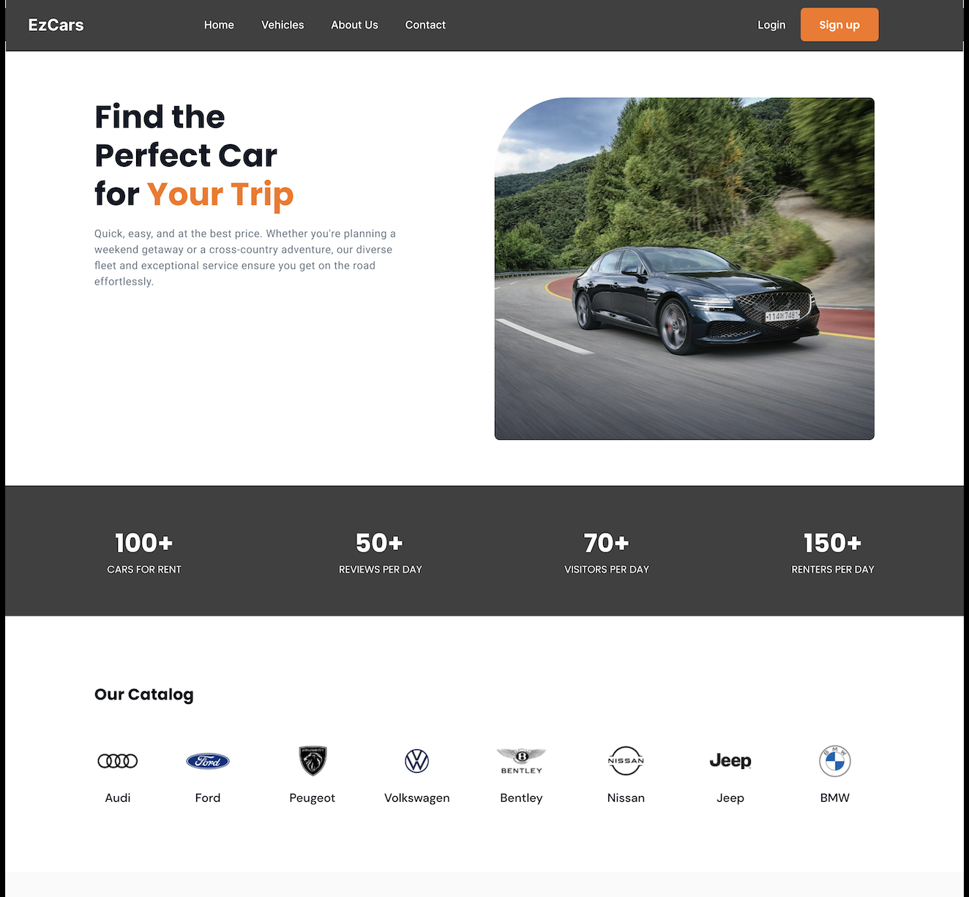
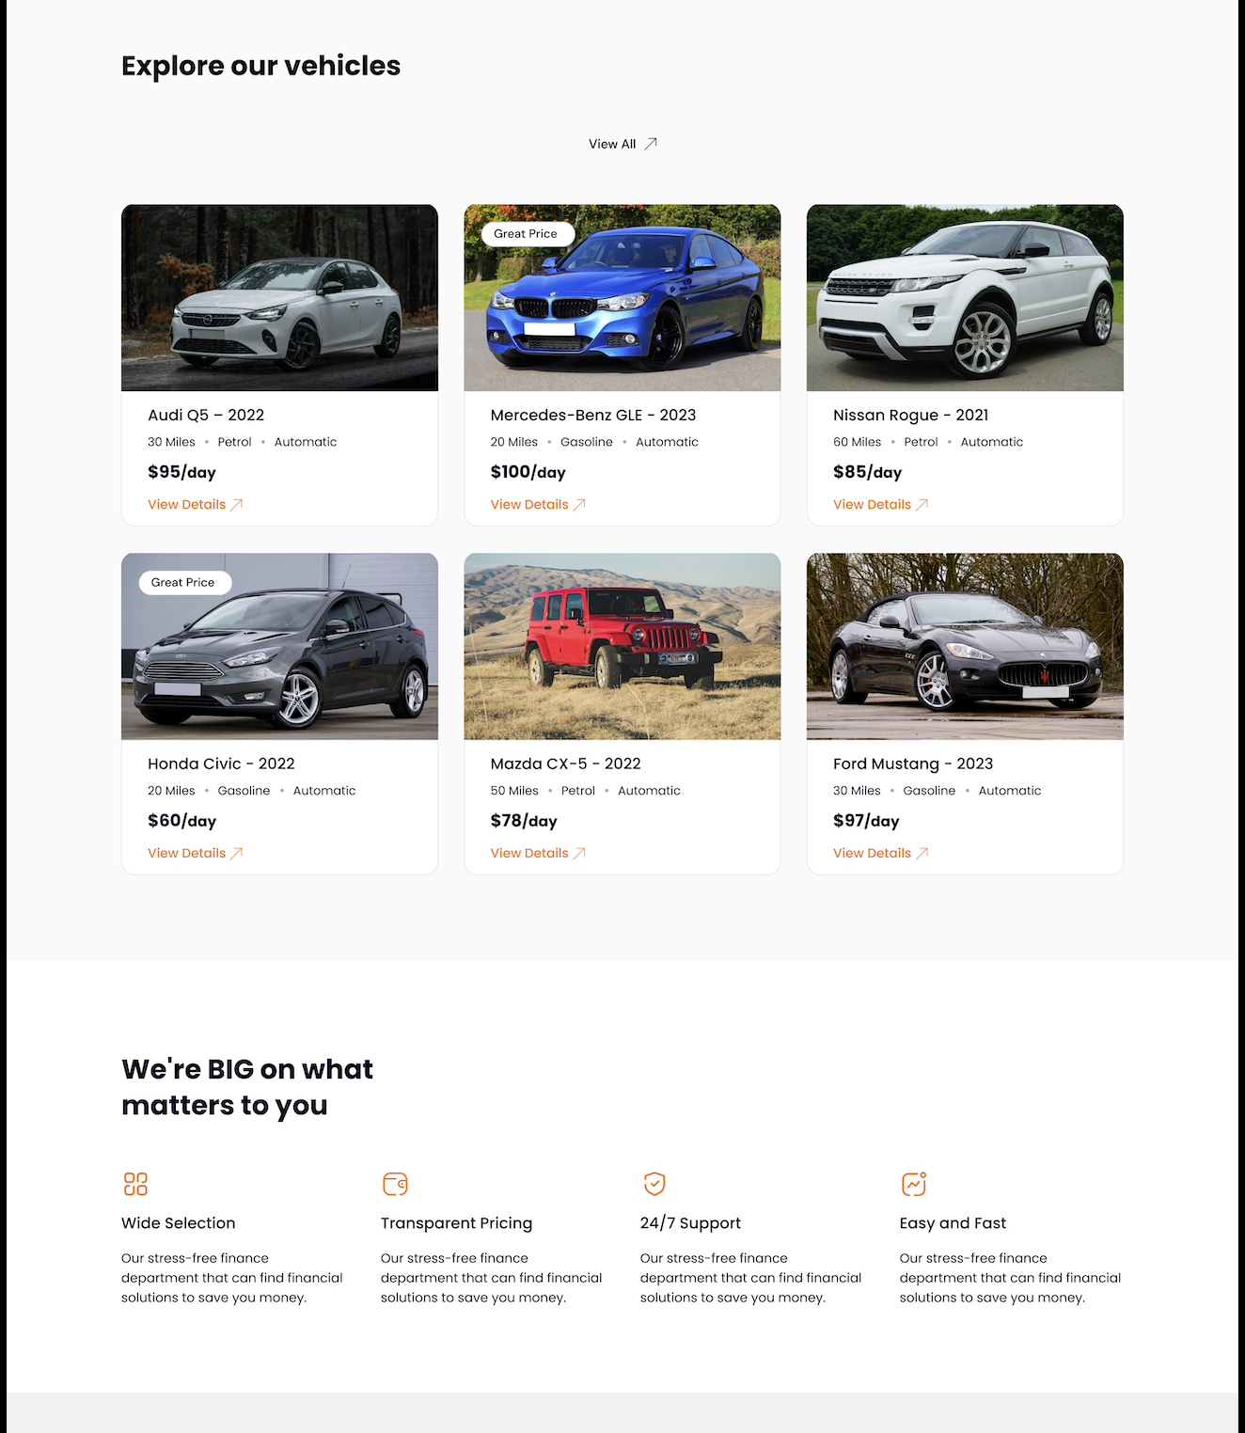
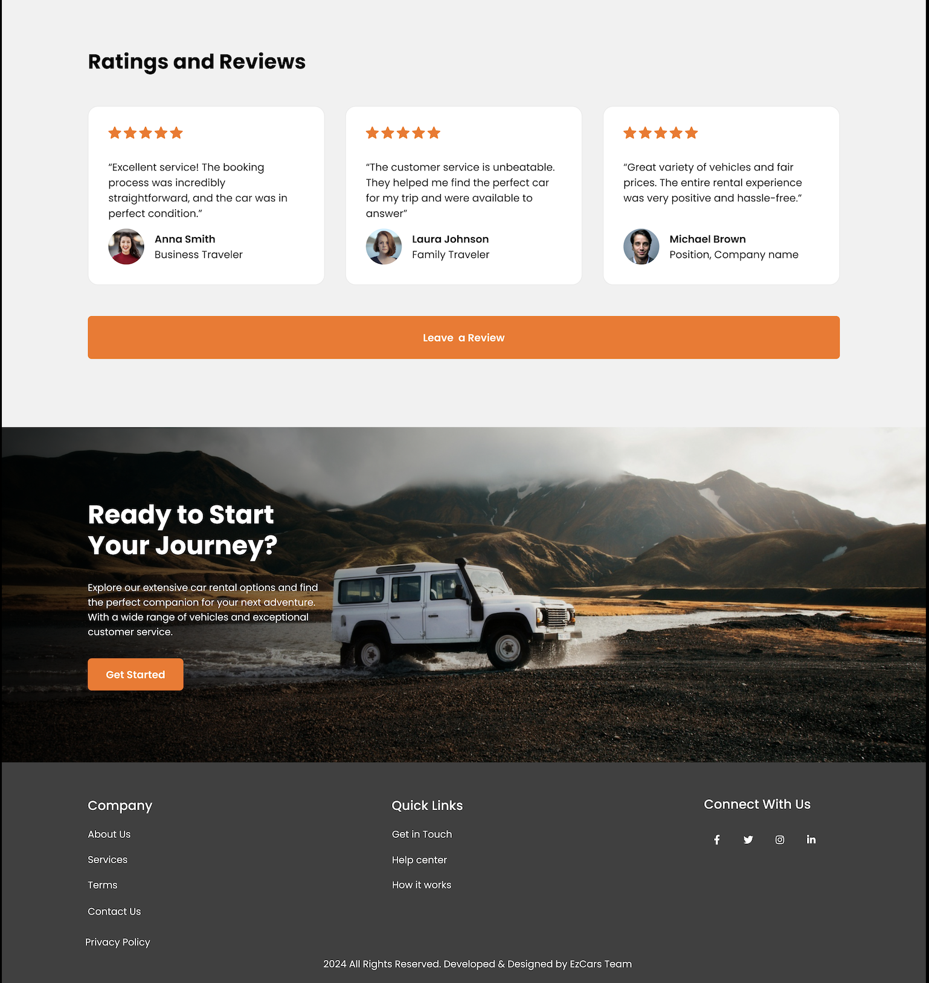
Home Page:

Slide 3
Navbar:
Home: Directs users to the homepage, providing an overview of the platform's offerings.
Vehicles: Takes users to the "Explore Vehicles" page, where they can search and filter a variety of vehicles based on their preferences.
About Us: Shares detailed information about the company, its mission, and its history.
Contact: Displays the contact details of the support team, including phone, email, and location, ensuring easy access for inquiries.
Login: Redirects to the login page for returning users to access their accounts.
Sign Up: Directs new users to the sign-up page to create an account and start exploring our services.

Slide 4
Main Page Features:
Introduction: The main page consists of the introduction of the company and the catalogs of the company.
Explore Vehicles: This page has information of the latest cars available for renting. The View details button displays the reservation page and the features of the car.
Services: This displays the services our company provides to the customers.
Reviews and Rating: This page displays the latest reviews and ratings. The customers can review all the reviews and rating and leave a review or comment.

Slide 5
Footer:
Company: This section provides key information about the company, including links to "About Us," "Services," "Contact Us," "Terms of Service," and "Privacy Policy," ensuring users can easily access important details about the business and its operations.
Quick Links: Contains helpful navigation shortcuts like "Get in Touch," "Help Center," and "How It Works," offering users a quick and efficient way to find support, understand the platform, and resolve any issues they may encounter.

